Slide 1
NACCHO Cancer Programs
9 & 10 July 2024
Dr Dawn Casey Deputy CEO NACCHO
Peter Bligh Director Cancer NACCHO

Slide 2
Why
Cancer is the leading cause of death
responsible for 23.4% of all deaths among Aboriginal and Torres Strait Islander peoples.
Aboriginal and Torres Strait Islander peoples experience cancer differently
lower cancer screening participation
higher cancer diagnosis rates
lower survival rates
2

Slide 3
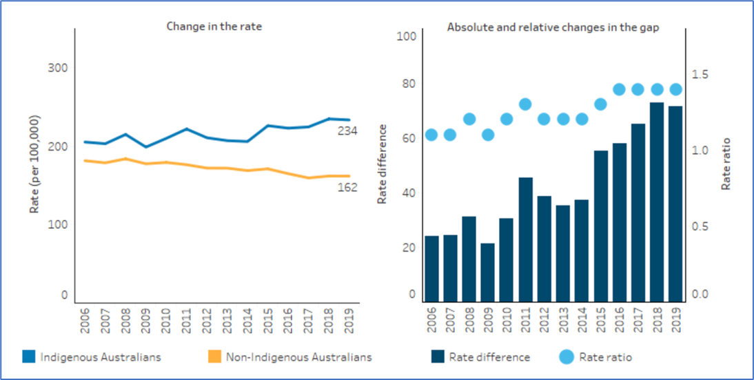
Why
Mortality rates have been declining for non-Indigenous people for at least two decades but cancer mortality for Aboriginal and Torres Strait Islander peoples has continued to increase.
3

Slide 4
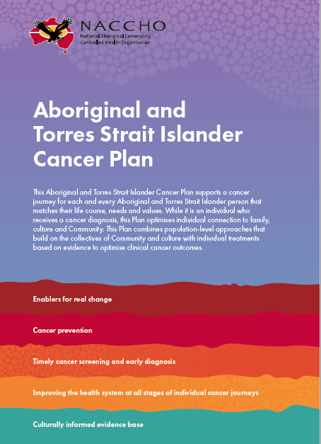
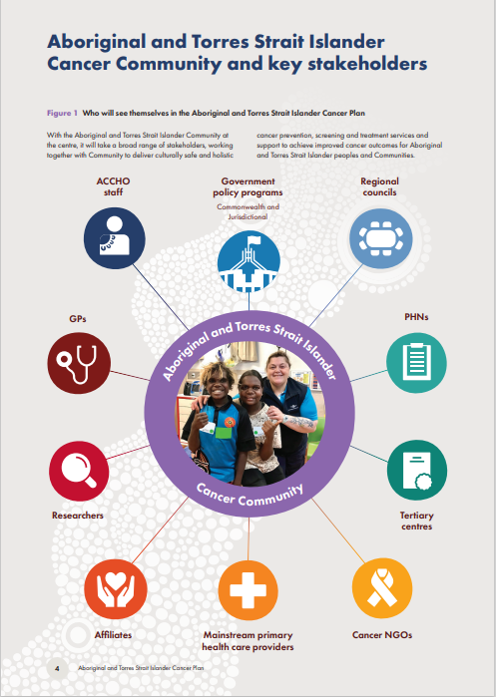
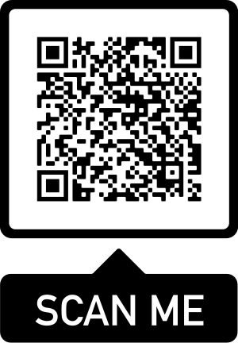
Aboriginal and Torres Strait Islander
Cancer Plan
4

Slide 5
NACCHO Cancer Programs
Other cancer programs of work include:
National Lung Cancer Screening Program
Cervical Screening Program
Bowel cancer screening
ACCHO Sector Cancer Program
5

Slide 6
National Lung Cancer Screening Program
NACCHO is working with the Department of Health and Aged Care and Cancer Australia on the National Lung Cancer Screening Program (NLCSP)
Screening will commence from 1 July 2025
The Program Guidelines are under development. These guidelines will support healthcare workers to guide participants through the program and ensure evidence-based best practice.
The development of materials to support shared decision-making and consent for Aboriginal and Torres Strait Islander people to participate in the NLCSP is being led by the Australian National University (ANU).
6

Slide 7
NLCSP PROGRAM ACTIVITIES
Tailored lung cancer screening participant information and workforce education materials will be developed with and for the ACCHO sector and Aboriginal and Torres Strait Islander people
Heart of Australia will be delivering mobile screening to rural and remote areas
NACCHO will be co-designing the routes over the coming months with ACCHOs, Heart of Australia and the Department of Health and Aged Care
Community Engagement grants will be available to ACCHOs from July 2025
7

Slide 8
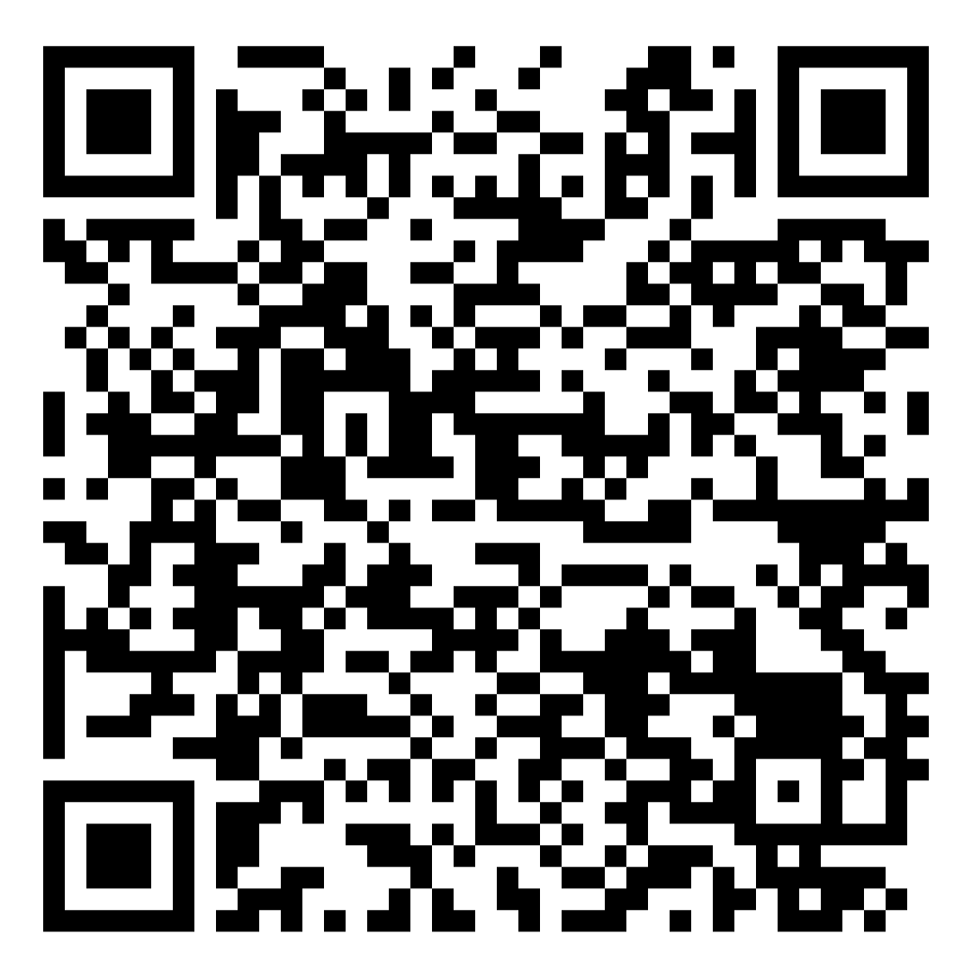
Aboriginal and Torres Strait Islander Consultations:
National Lung Cancer Screening Program Guidelines
Consultations led by A/Prof Lisa Whop, A/Prof Raglan Maddox, and Miss Samantha Pope.
Looking to talk with:
Aboriginal and Torres Strait Islander people who are eligible for the lung cancer screening program or will be in the next five years:
1) aged 45 years or older AND
2) people who currently smoke or have smoked in the past ten years
People who have family or care for others, as well as health or support workers.
Those who have been affected by lung cancer.
Opportunity to join online consultations on Wednesday 17 and Thursday 18 July
(Scan QR code to register)
If you would like to join but these dates don't suit, email Lisa: lisa.whop@anu.edu.au
8

Slide 9
Cervical
National Campaign:
NACCHO is working to co-design a national education awareness campaign
The campaign aims to maximise the benefit and uptake of self-collect cervical screening in various underscreened populations, including Aboriginal and Torres Strait Islander peoples
The campaign will focus on both Aboriginal and Torres Strait Islander women and people with a cervix aged between 25-74 years and the healthcare professionals who provide care to these community members
9

Slide 10
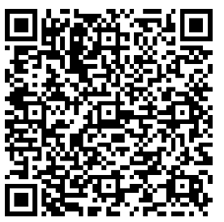
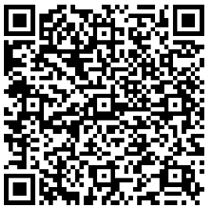
Webinars
2 x 1-hour information sessions on HPV self-collection (cervical screening)
Open to all ACCHO staff wanting to learn more about self-collect cervical screening
Webinar 1: Webinar 2:
Date: Tuesday the 30th of July Date: Wednesday the 14th of August
1-2PM AEST 2-3PM AEST
Registration QR code Registration QR code
Health promotion materials
We will be sending health promotion resources to all ACCHOs soon! Watch this space!
10

Slide 11
Bowel cancer screening
Alternative Access Model (AAM) - community members can receive bowel cancer screening kits directly from a healthcare professional at their local ACCHO
NACCHO was funded for the roll out of the AAM until August 2023, however, continues to support ACCHOs with bowel cancer screening to improve screening participation rates
Bowel cancer screening age has been lowered 50 to 45 from 1 July 2024
11

Slide 12
ACCHO Sector Cancer Program
Improving First Nations Cancer Outcomes Program was announced after the May 2023 Budget
Program provides funding over three years
Tailored to local needs and priorities to achieve equitable outcomes across a cancer journey
Focus on reshaping the cancer narrative through a strengthened workforce (260 FTE) particularly in remote and very remote areas
12

Slide 13
Affiliate Cancer Workforce
Cancer Liaison Officers (CLOs)
CLOs are state/territory-based roles that will:
Work with program governance to identify the needs and priorities of their jurisdiction and ensure ACCHOs are enabled to deliver cancer services and support to Community members​
Advocate and work with state and territory governments and networks to support the development of relevant and culturally appropriate cancer policy and programs that reflect the National Agreement on Closing the Gap​
Participate in the Community of Practice
13

Slide 14
Workforce
The following positions will be funded through the Program:​
​
Positions | FTE
Cancer Liaison Officers | Up to 10 FTE Affiliates
Health Promotion Officers | Up to 100 FTE ACCHOs
Cancer Support Officers | Up to 100 FTE ACCHOs
Cancer Treatment Health Practitioners | Up to 50 FTE ACCHOs
14

Slide 15
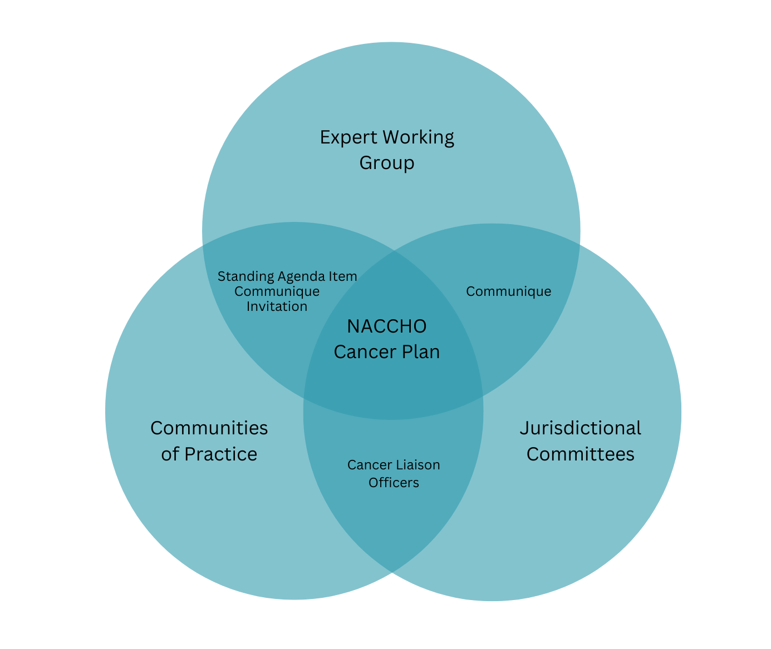
ACCHO Sector Cancer Program Governance
15

Slide 16
Update - Outpatient chemotherapy services
Investigating the potential to provide low-level chemotherapy services to remote areas for outpatients.
Dr Anthony Zheng (Principal Consultant – Public Health Matters) to produce:
evidence review on the state of outpatient chemotherapy services
a draft implementation strategy for outpatient chemotherapy services to be delivered within ACCHOs
16

Slide 17
NACCHO Cancer Model
17

Slide 18
Questions
Bowel Screening
How are follow up screenings conducted?
What systems would make it easier for ACCHOs to conduct bowel screenings?
Breast Screening
How are follow ups of Breast Screenings conducted?
Provide cases of what is working or ideas of what does work?
Highlight issues of what clients face out of community obtaining referrals?
18

Slide 19
SUMMARY & WRAP UP
23

Slide 20
Contact
Email: cancer.team@naccho.org.au
23

