Slide 1
Maternal and Child Health Plan 2025-2035
Monica Barolits-McCabe, Executive Director, NACCHO
Alex Grant, Director Maternal & Child Health, NACCHO

Slide 2
Objectives for this session
Provide an update on the Antenatal to School-Ready MCH Plan​
Outline our consultation process & key findings to date​
Seek feedback on NACCHO’s proposed Framework & Pillars​ ​
Share next steps

Slide 3
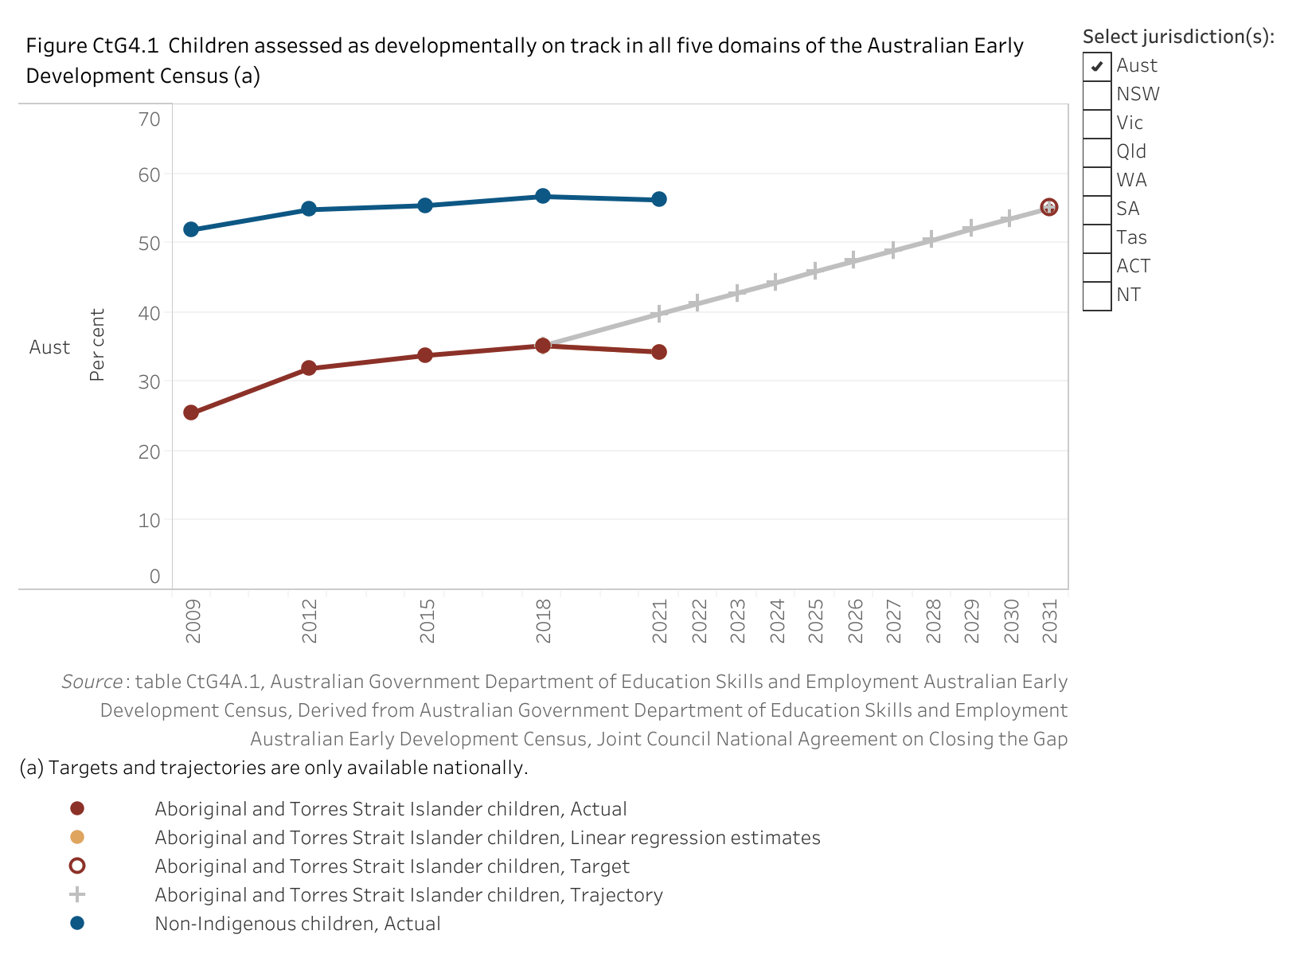
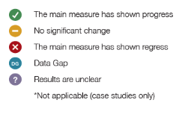
Background and Context
Are we Closing the Gap in Maternal and Child Health?

Slide 4
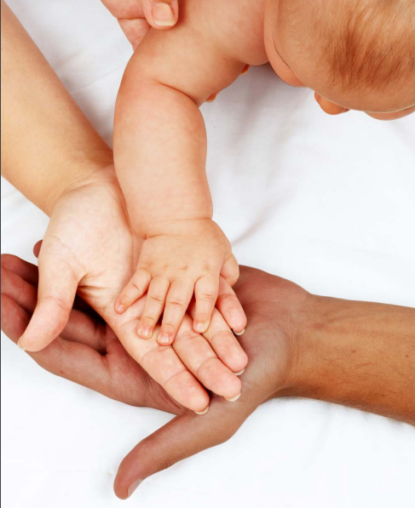
Why an Antenatal to School-Ready MCH Plan 2025-2035?
Coordinate and improve MCH services to progress Closing the Gap for mums and bubs by prioritising prevention and early support.
Epigenetics research shows the importance of the first 2,000 days
Child’s development score at 22 months is an accurate predictor of education outcomes

Slide 5
Purpose
Closing the Gap for mums and bubs through Government investment in outcomes, not inputs or outputs.
Guide Commonwealth’s policy & investment in Aboriginal and Torres Strait Islander MCH over next 10 years
Long-term holistic approach to enable flexible, place-based models of care
Agency to progress your MCH priorities and deliver what you know works
Inform NACCHO's pre-budget Submission to Department of Health and Aged Care
Funding in May 2025 Budget

Slide 6
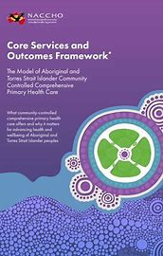
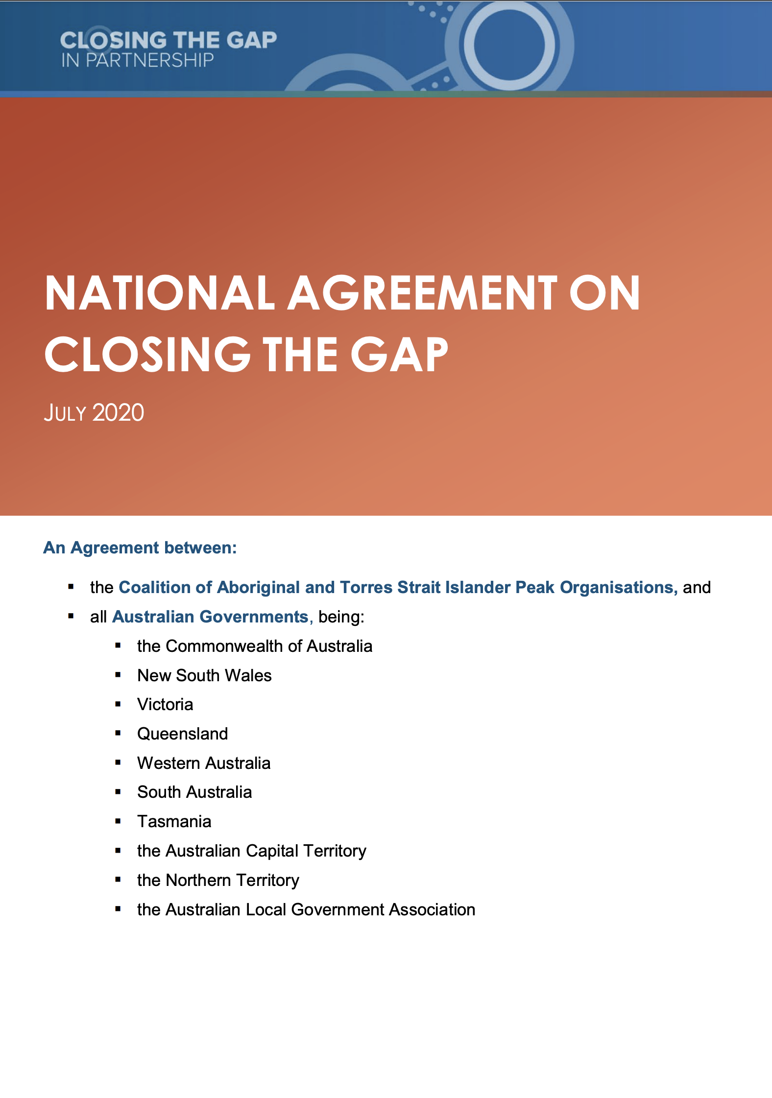
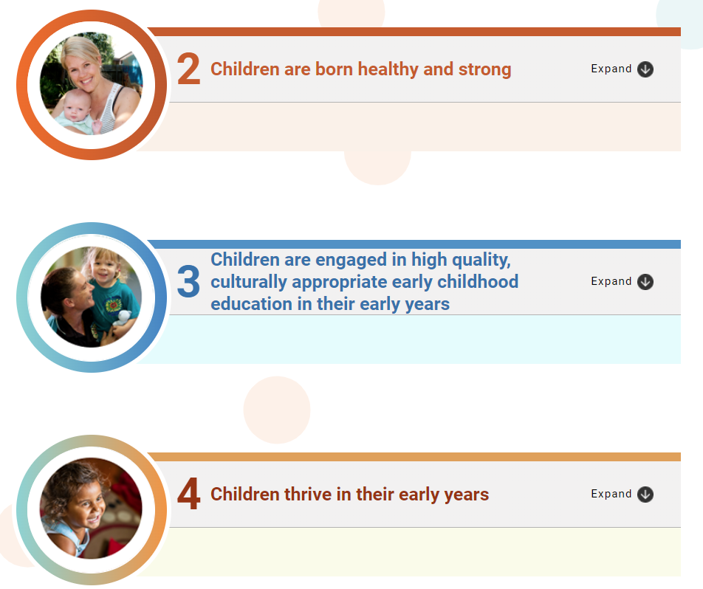
Align & complement - not duplicate

Slide 7
Consultation Process
NACCHO Conference Workshop 2022 and 2023
Technical paper reviewed evidence base
MCH Expert Panel (ongoing)
NACCHO sector-wide MCH survey (May-June 2024)
52 ACCHOs responded from all states and the NT

Slide 8
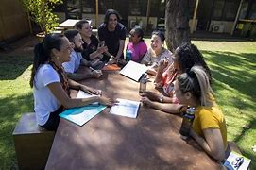
Interviews with survey respondents and deep-dives on MCH models of care (July)
Regional Workshops (August)
NACCHO pre-Budget submission (September 2024)
Launch of final Plan (October 2024)
NACCHO Member Conference (December 2024)
Federal Budget (May 2025)

Slide 9
Sector feedback and insights
Funding and workforce identified as key barriers at MCH Workshop, 2023 NACCHO Conference

Slide 10
Successful Maternity Services
- Thematic analysis from MCH Survey
Continuity of Care
Partnerships and Collaboration
Importance of being able to form a relationship with staff throughout the perinatal and early childhood period, with several mentions of midwife-led care and maternal outreach services.
Partnerships between Aboriginal Medical Services, hospitals, and GP practices, including efforts to improve service integration, referral pathways, and overall care coordination
“We currently have visiting services support our parents, and a nurse onsite which provides follow up support as required. These 2 services coordinate between each other to ensure they are meeting the needs of the family.”
“Australian Nurse Partnership Program (ANPP). Close support with first time expectant mums, and then up to 2 years post partum.”
“AMIC program- AHW works in partnership with midwife, GP's and hospital staff to support and advocate for the woman.”
Culturally Safe Education
Community Engagement
Accessibility
“Antenatal classes consists of delivering information in a culturally safe and relaxed atmosphere ”
“Strong Born - whole of community participation to support women and their partners too remain alcohol free to eliminate the possibility of FASD.”
“Support workers and midwife providing transport and emotional support at appointments as required, leading to enhanced trust and engagement with care.”

Slide 11
Three biggest improvements needed in MCH -
Thematic analysis from MCH Survey
Social Supports
Community
Workforce
Need for more Aboriginal and Torres Strait Islander staff in perinatal healthcare settings, as well as training existing staff in culturally safe practices.
Addressing socioeconomic challenges faced by pregnant women and families.
Importance of community-driven support and the role of families in maternal health.
“Helping lift mothers and families out of pure survival mode by addressing the chronic and escalating rural housing crisis, the poverty, the inherent drugs and alcohol problems etc.”
“Minimally one escort for each mother coming in for sit-down or for delivery. This factor needs the most urgent attention and should be easily reconcilable”
“Availability of ALO's, AHP's, and/or AHW's in the hospital system that are especially assigned to maternity care”
Continuity of Care
Collaboration
Education
Cultural Safety
“Consistent staffing, including during the first 1000 days”
“Better collaboration between healthcare providers for follow up care after leaving hospital and returning to country”
“Culturally appropriate antenatal classes for expectant parents”
“Culturally responsive care within hospital and health services where women feel safe and not judged.”

Slide 12
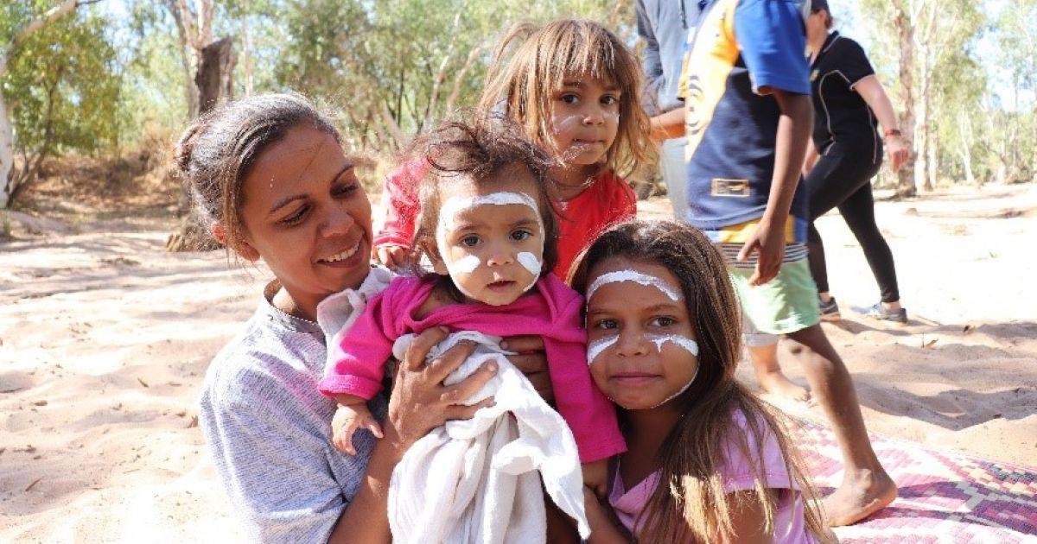
Maternal and Child Health Plan 2025-2035
Vision
Thriving mums and strong, school-ready children enjoy long, healthy lives that are centred in culture, with access to services that are prevention-focused, culturally safe and responsive, equitable and free of racism

Slide 13
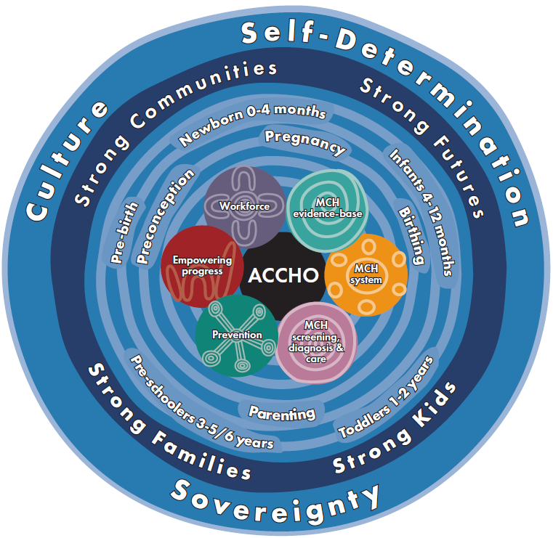
Rights-based, outcomes driven approach across life-course
Increase ACCHO autonomy and agency to meet community MCH needs
Staged implementation plans
Strengthen regional coordination and planning
Facilitate partnerships with mainstream orgs
Reduce reporting burden by measuring what matters

Slide 14
Discussion
Q1: Does this model reflect the sector’s vision for MCH?

Slide 15
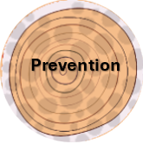
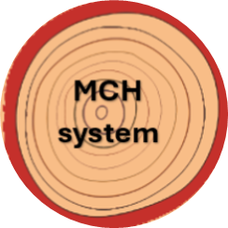
Draft Plan pillars

Slide 16
Shared decision making
Partnerships
Accommodation & infrastructure
Transport
Legal, policy & insurance frameworks
Awareness raising
Sustainable & adequate investment in MCH Care
Grow Aboriginal & Torres Strait Islander workforce
Work at scope of practice
Retain & upskill existing MCH staff
Sustainable employment initiatives
Pipeline of MCH training

Slide 17
Advocacy & policy
Culturally safe mainstream services
Communication & data sharing
Birthing on Country
MCH Navigators
Integrated approaches
Referral pathways
Capacity building
Access to medicines, equipment & care
Indigenous Data Sovereignty
Data infrastructure
Birthing on Country
PIMS
Community of Practice / sharing
Research translation into policy & practice

Slide 18
Immunisations
Birthing on Country
Environmental health
Healthy homes
Early support to mums & bubs
Health promotion
Social & economic determinants
Ear health
Access to tools, resources & training
Coordinators
Regional referral pathways
Local Models of Care
ARF / RHD
Integrated case management

Slide 19
Table Activity 1
Q2: Do these pillars reflect your top priorities? Any missing?
Q3: How do we strengthen the activities under each pillar?

Slide 20
Proposed funding approach
Phased transition to streamlined, sustainable and adequate MCH block funding
Consolidate and integrate patchwork of siloed MCH funding streams and programs +
Transition mainstream MCH funding into ACCHOs +
Invest new money (incl in infrastructure + accommodation)
United Nations Pooled Funding concept to promote greater flexibility

Slide 21
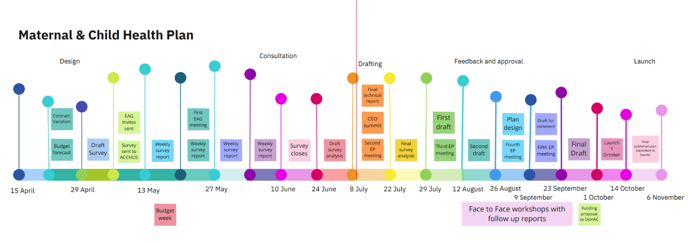
Timeline and next steps

Slide 22
Table Activity 2
Q4: What are the most critical issues that need immediate attention to address gaps and opportunities?
Q5: How can we build sustainability into the Plan to ensure long-term impact?

Slide 23
Reminder
FASD Grant Round 3 is open now!
Apply for funding to deliver a local Strong Born campaign

