Slide 1
The Derbarl Yerrigan Health Service
approach to embedding CQI in our
clinical and governance practices
Alvin Edney RN
Clinical Governance Manager
Dr Daniel Hunt: Deputy MD
Dr Lakhbinder Singh Kang : GP and CQI Lead

Slide 2
Notes:
We acknowledge the Whadjuk Noongar people as the traditional custodians of the Boodjar we meet on today and pay our respects to their continuing connection to the land, waters and community

Slide 3
Who we are
The Derbarl Yerrigan Health Service is the largest and oldest Aboriginal Community Controlled Health Organisation in Western Australia providing culturally responsive primary health care for the Aboriginal population across Whadjuk Noongar Boodjar.

Slide 4
Our Clinics
Notes:
4 sites: East Perth, Maddington, Mirrabooka and Midland

Slide 6
Recognition
2023 RACGP (WA) BEST GP SERVICE WINNER
Notes:
2023 RACGP (WA) Best GP Service Winner

Slide 7
Our Board
Professor Dan McAullay
Chairperson
Professor Sandra Eades AO
Deputy Chairperson
Robert Morrison
Member Director
Thierra Clanton
Member Director
Vacancy
Member Director
Paul Gregory
Specialist Independent Director
Brian Roche
Specialist Independent Director
Notes:
Chairperson is Professor Dan McAullay, Deputy chair is Professor Sandra Eades
7 positions , one of which is vacant
2 specialist independent directors

Slide 8
Our People
Patient Numbers
Staff Numbers
20,065*
178
Aboriginal Employees
* 16,114 regular
1,672 new patients
59%

Slide 9
Our Model of Care
Our model focuses on the wellbeing of our clients:
Socially
Emotionally
Physically
Derbarl’s Clinical services, health promotion, cultural safety, membership engagement and community governance are core to our service.
Aboriginal Health Council of WA MoC

Slide 10
The Derbarl Model of Care
Our model of care includes a patient-focused GP and Aboriginal Health Practitioner shared care approach, integrated with:
allied health and specialist services
environmental health
dental services
mental health and social supports;
with access enabled through transport services or outreach medical care.
Our model is underpinned by a clinical quality-improvement (CQI) program.
Aboriginal Health Council of WA MoC

Slide 12
OUR SERVICES
In addition to doctors, nurses and Aboriginal health practitioners,
we have a range of health services:
Primary Care
Dental Services
Podiatry
Sexual health
Environmental Health
Maternal & Child health and Paediatric Clinic
Aboriginal Disability Support Program
Immunisation and Vaccination Programs
Notes:
Primary Care , Dental Services
Podiatry, Sexual health
Environmental Health
Maternal & Child health and Paediatric Clinic
Aboriginal Disability Support Program
Immunisation and Vaccination Programs

Slide 13
OUR SUPPORT SERVICES
Dementia Clinic
Home visits and transport
Hospital Discharge follow-up
Advocacy
Health Promotions
Tackling Indigenous Smoking
Needle and syringe program
Continuous Quality Improvement Program
Research
Optometry
Subsidised Spectacles and Retinal Eye Care
COVID Care
Notes:
Dementia Clinic, Home visits and transport
Hospital Discharge follow-up, Advocacy
Health Promotions/Tackling Indigenous Smoking
Needle and syringe program, Continuous Quality Improvement Program
Research, Optometry/ Subsidised Spectacles and Retinal Eye Care
COVID Care

Slide 14
OUR SUPPORT SERVICES
Social and Emotional Well-Being (SEWB)
Counsellors
Social Worker
Mental Health Clinicians
Family and Domestic Violence Support Service
Advocacy
Suicide Prevention
Homeless Support
Cancer Support
Elders Connect Program
Elders Yarning Group

Slide 15
VISITING
SPECIALIST SERVICES
Cardiologist
Endocrinologist
Gastroenterologist
Gynaecology
Developmental Paediatrics
Optometrist
Audiology
Allied Health Services
ENT
Geriatric
Psychiatrist
Adult and child dermatology
Dementia Clinic
Renal Physician
Respiratory Physician

Slide 16
ATTENDANCE RATES
FOR SPECIALIST CLINICS
Derbarl Clinics Other Health Svs

Slide 17
Derbarl’s evolving CQI journey
WAPHA fund Hep C project 2019
NP and Dr Laki get involved
Dr Richelle gets involved Nov 2019
CQI working group formed 2020
Registrars
Nurses
Clinial Governance Manager
Sexual Health Team
AHPs
Beyond the C funding 2021 and 2023
ASHM and Gilead
Current projects on the go: 29

Slide 18
Ongoing CQI at Derbarl

Slide 19
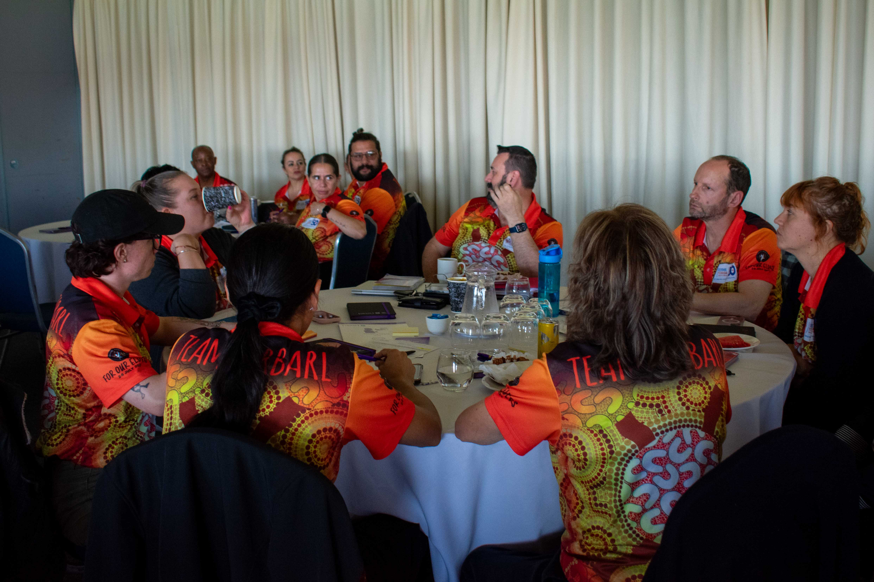
CQI at Derbarl
What does CQI mean to DYHS
Quality
Safety
Equity
Why do we do it
Admissions + death 3x higher
Burden of disease 2.3x higher
Closing the gap
How is it funded?
Are there KPIs/measures involved
National KPIs (26)

Slide 20
CQI – Why?
Patient
Best practice
Minimise clinical risk
Capture data
- Excellence of care to CTG
- Improvement opportunities
- Direct resources
- Efficiency
- Funding
Staff
DYHS

Slide 21
CQI – Why?
Financial vs Patient Outcomes
How are the two linked?
Making money vs saving money vs protecting future interests vs reducing risk

Slide 22
CQI – Supports
CQI
NACCHO Framework
CQI Sub-committee
All DYHS staff
CQI Champions
Dr Daniel Hunt, Dr Richelle Douglas, CEO Tracey Brand
CQI Lead
Board

Slide 23
Continuous
Kwobidak
Improvement
Kwobidak/Kowbardak: Noongar, adj; Pretty or Beautiful

Slide 24
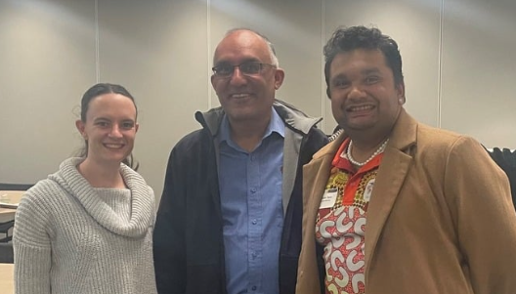
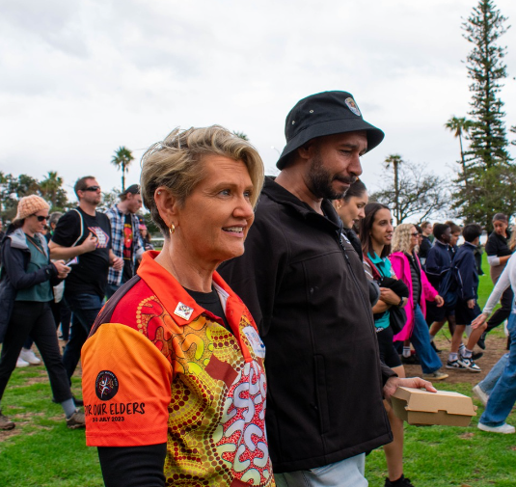
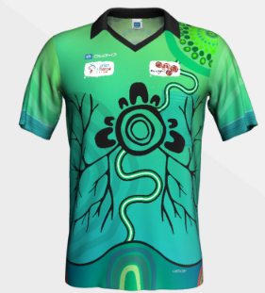
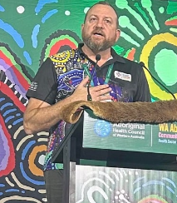
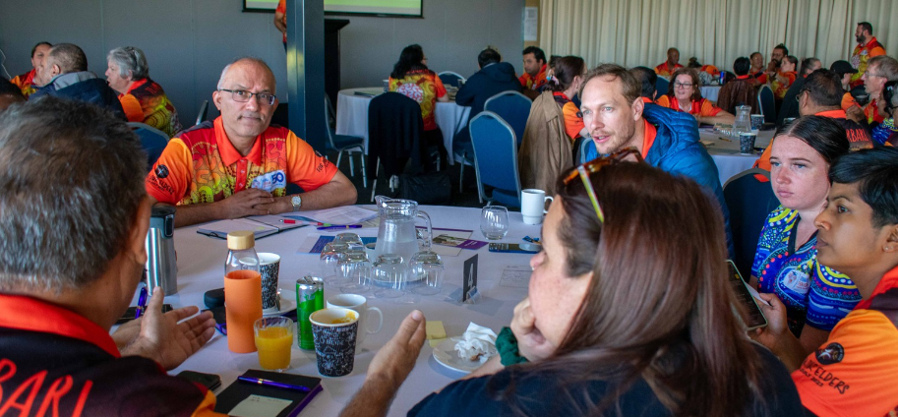
CQI at Derbarl
CQI is currently embedded into DYHS
On a clinical level
On an organizational level
Plans for future change?
Growth will depend on Communicare and Clinical Items
Central CQI Library
Resources

Slide 25
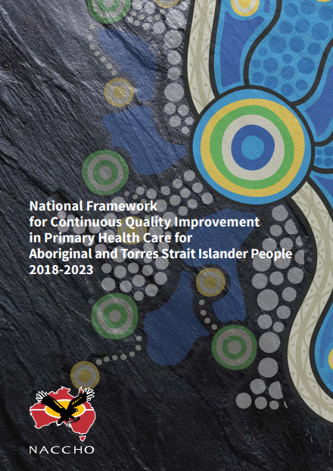
CQI Framework
How is this document guiding CQI at DYHS?
Aims:
Close the gap in ATSI life expectancy by 2031
Halve the gap in mortality rates of children <5 years by 2028
Why is this document important or relevant?
Case Studies:
VACCHO Webinar – dashboard
AHMRC – smoking brief intervention
Immunisation Rates in NT
NKPI Support
Board issue at Danila Dilba
Child Ear health

Slide 26
CQI Questions
How are we doing?
What problem are we trying to solve
Can we do better?
How will we know if it is better?

Slide 27
CQI Framework
Areas for action
Develop and test strategies
Implement Service redesign
Executive team
Alongside:
Accreditation
Clinical Governance
Monitoring
Evaluation

Slide 28
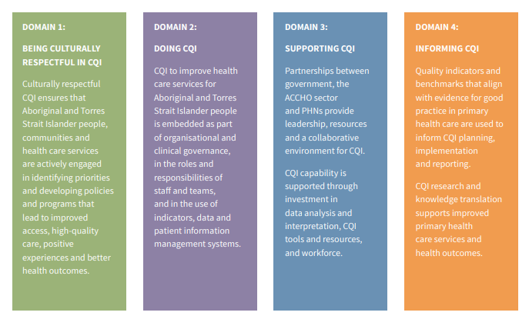
CQI Domains

Slide 29
CQI Audits
Hepatitis B and C
Diabetes
Rheumatic heart disease
Chronic kidney disease
Asthma/ COPD

Slide 30
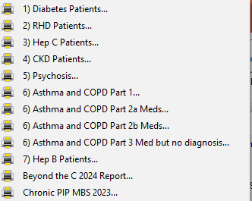
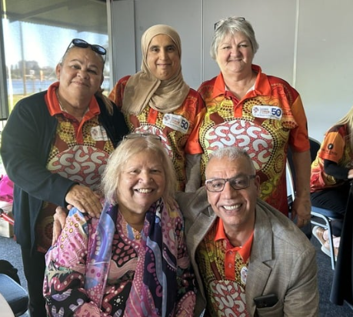
Communicare Audits

Slide 31
CQI in Practice
Hepatitis C
An effective oral treatment for hepatitis C was added to the PBS in 2016
Curing hepatitis C reduces the risk of cirrhosis and liver cancer
However case finding was a challenge;
Data recorded in Communicare was inaccurate
Many patients were experiencing barriers to receiving treatment
Funding was received;
From WAPHA in 2019
From ASHM (Beyond the C) in 2021 and 2023

Slide 32
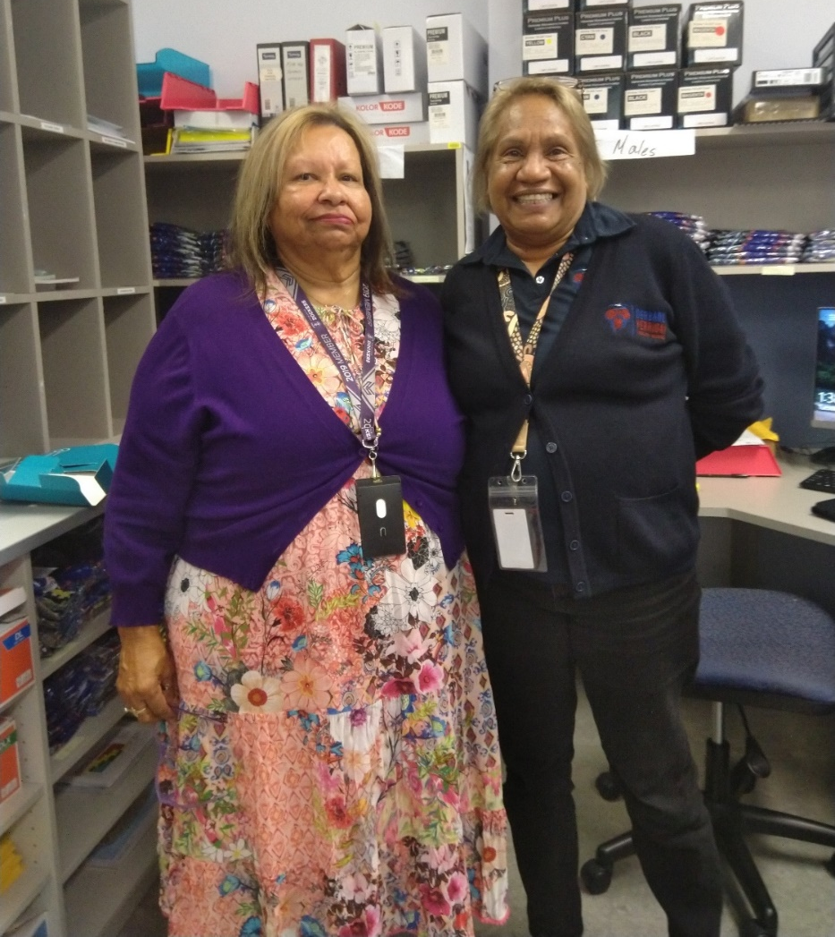
CQI in Practice
Hepatitis C
Standardisation of clinical items
Audit tool
HCV champions at each clinic site
HCV-specific GP Management Plan template
Resources to facilitate workup and treatment;
transport and outreach ALO
prescribers within DYHS
liaison with tertiary hospital clinics
liaison with community HCV specialist clinic
Addressing barriers to treatment and follow-up
Close relationship with pharmacy, webster packing

Slide 33
CQI in Practice
Hepatitis C
Clearance rate = Cleared cases / Total cases
= 445 / 631 x 100
= 70.5%
REGULAR patient data
Infections (Ab positive) | 631 regular/ 1274 total
Cleared (Ab positive, RNA neg) | 445
Positive (Ab positive, RNA pos) | 95
Undefined (Ab pos, RNA unknown) | 16
Barriers to f-up | 75

Slide 34
CQI in Practice
Hepatitis C
50 yo man
Hx incarceration
Hx IVDU: ceased years earlier
Hx heavy alcohol consumption: now abstinent
Hep C RNA positive in 2010
Referred by his previous GP to a tertiary hepatology clinic
for treatment of hepatitis C
Appointments made in 2018 and 2019
On both occasions he did not attend and discharged from the service

Slide 35
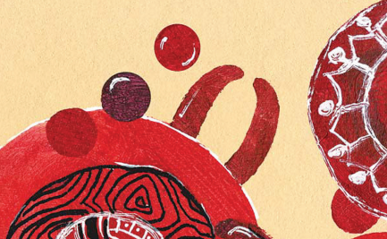
CQI in Practice
Hepatitis C
He started to attend Derbarl in 2021
We identified he was HCV positive through case finding, completed his work-up and discussed treatment options
Genotype 1A
Non cirrhotic, APRI 0.53
USS liver unremarkable
Series of delays and barriers to commencing treatment
- Periods living in north of WA
- Unable to receive phone calls
- Significant drug interaction identified
- Several hospitalisations with unrelated illnesses
However, with the dedication of the whole team,
we strove to overcome these barriers

Slide 36
CQI in Practice
Hepatitis C
Late 2022 we re-established care
We consulted the REACH-C specialist re: drug interactions
Maviret recommended and prescribed for 8 weeks
Organised webster packing and fortnightly delivery to ensure treatment taken reliably
SVR4 recently negative (CURE) – finally!

Slide 37
CQI in Practice
Hepatitis B
Significant but unknown case numbers.
Management was not standardised.
Risk of missing care opportunities.
Emerging funding opportunities

Slide 38
CQI in Practice
Hepatitis B
Created standardised clinical items on Communicare.
Comprehensive, including immunisation and contact tracing.
Audit reports allows real time data.
Renewed patient reminder and recall systems.
Hep B monitoring – liver function and viral load
HCC surveillance – AFP and liver USS
Role of Hepatitis B champions, Aboriginal Health Practitioners and Sexual Health team.

Slide 39
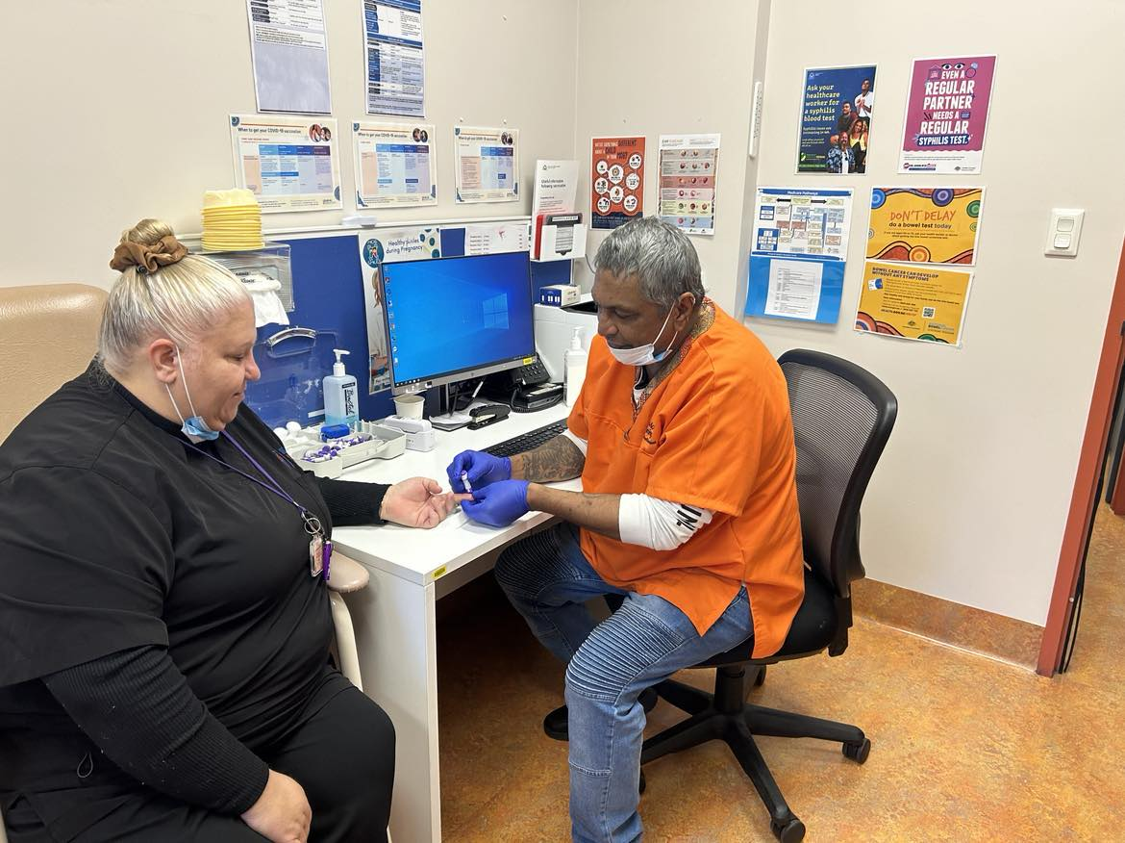
CQI in Practice
Hepatitis B
Outcome: 46 regular patients with chronic hepatitis B
Relationship built with RPH hepatology team
Commenced Liver MDT meetings 4th June 2024
- Ability to fast track liver fibroscans
- Sharing of information from hospital records
- Commencement of treatment
- Enable rapid access to care, such as expedited scopes
- Support not to discharge patients due to non-attendance
- Potential funding opportunities identified

Slide 40
CQI in Practice
Hepatitis B
Case 1
20 yo
Resides between Perth and northern WA
Identified as having CHB
Recent elevated ALT, however no viral load on record
MHR confirms currently 2-3 trimester of pregnancy
Discussed at MDT and advised re risk vertical transmission
Phone call to antenatal team: unaware of need for specialist care

Slide 41
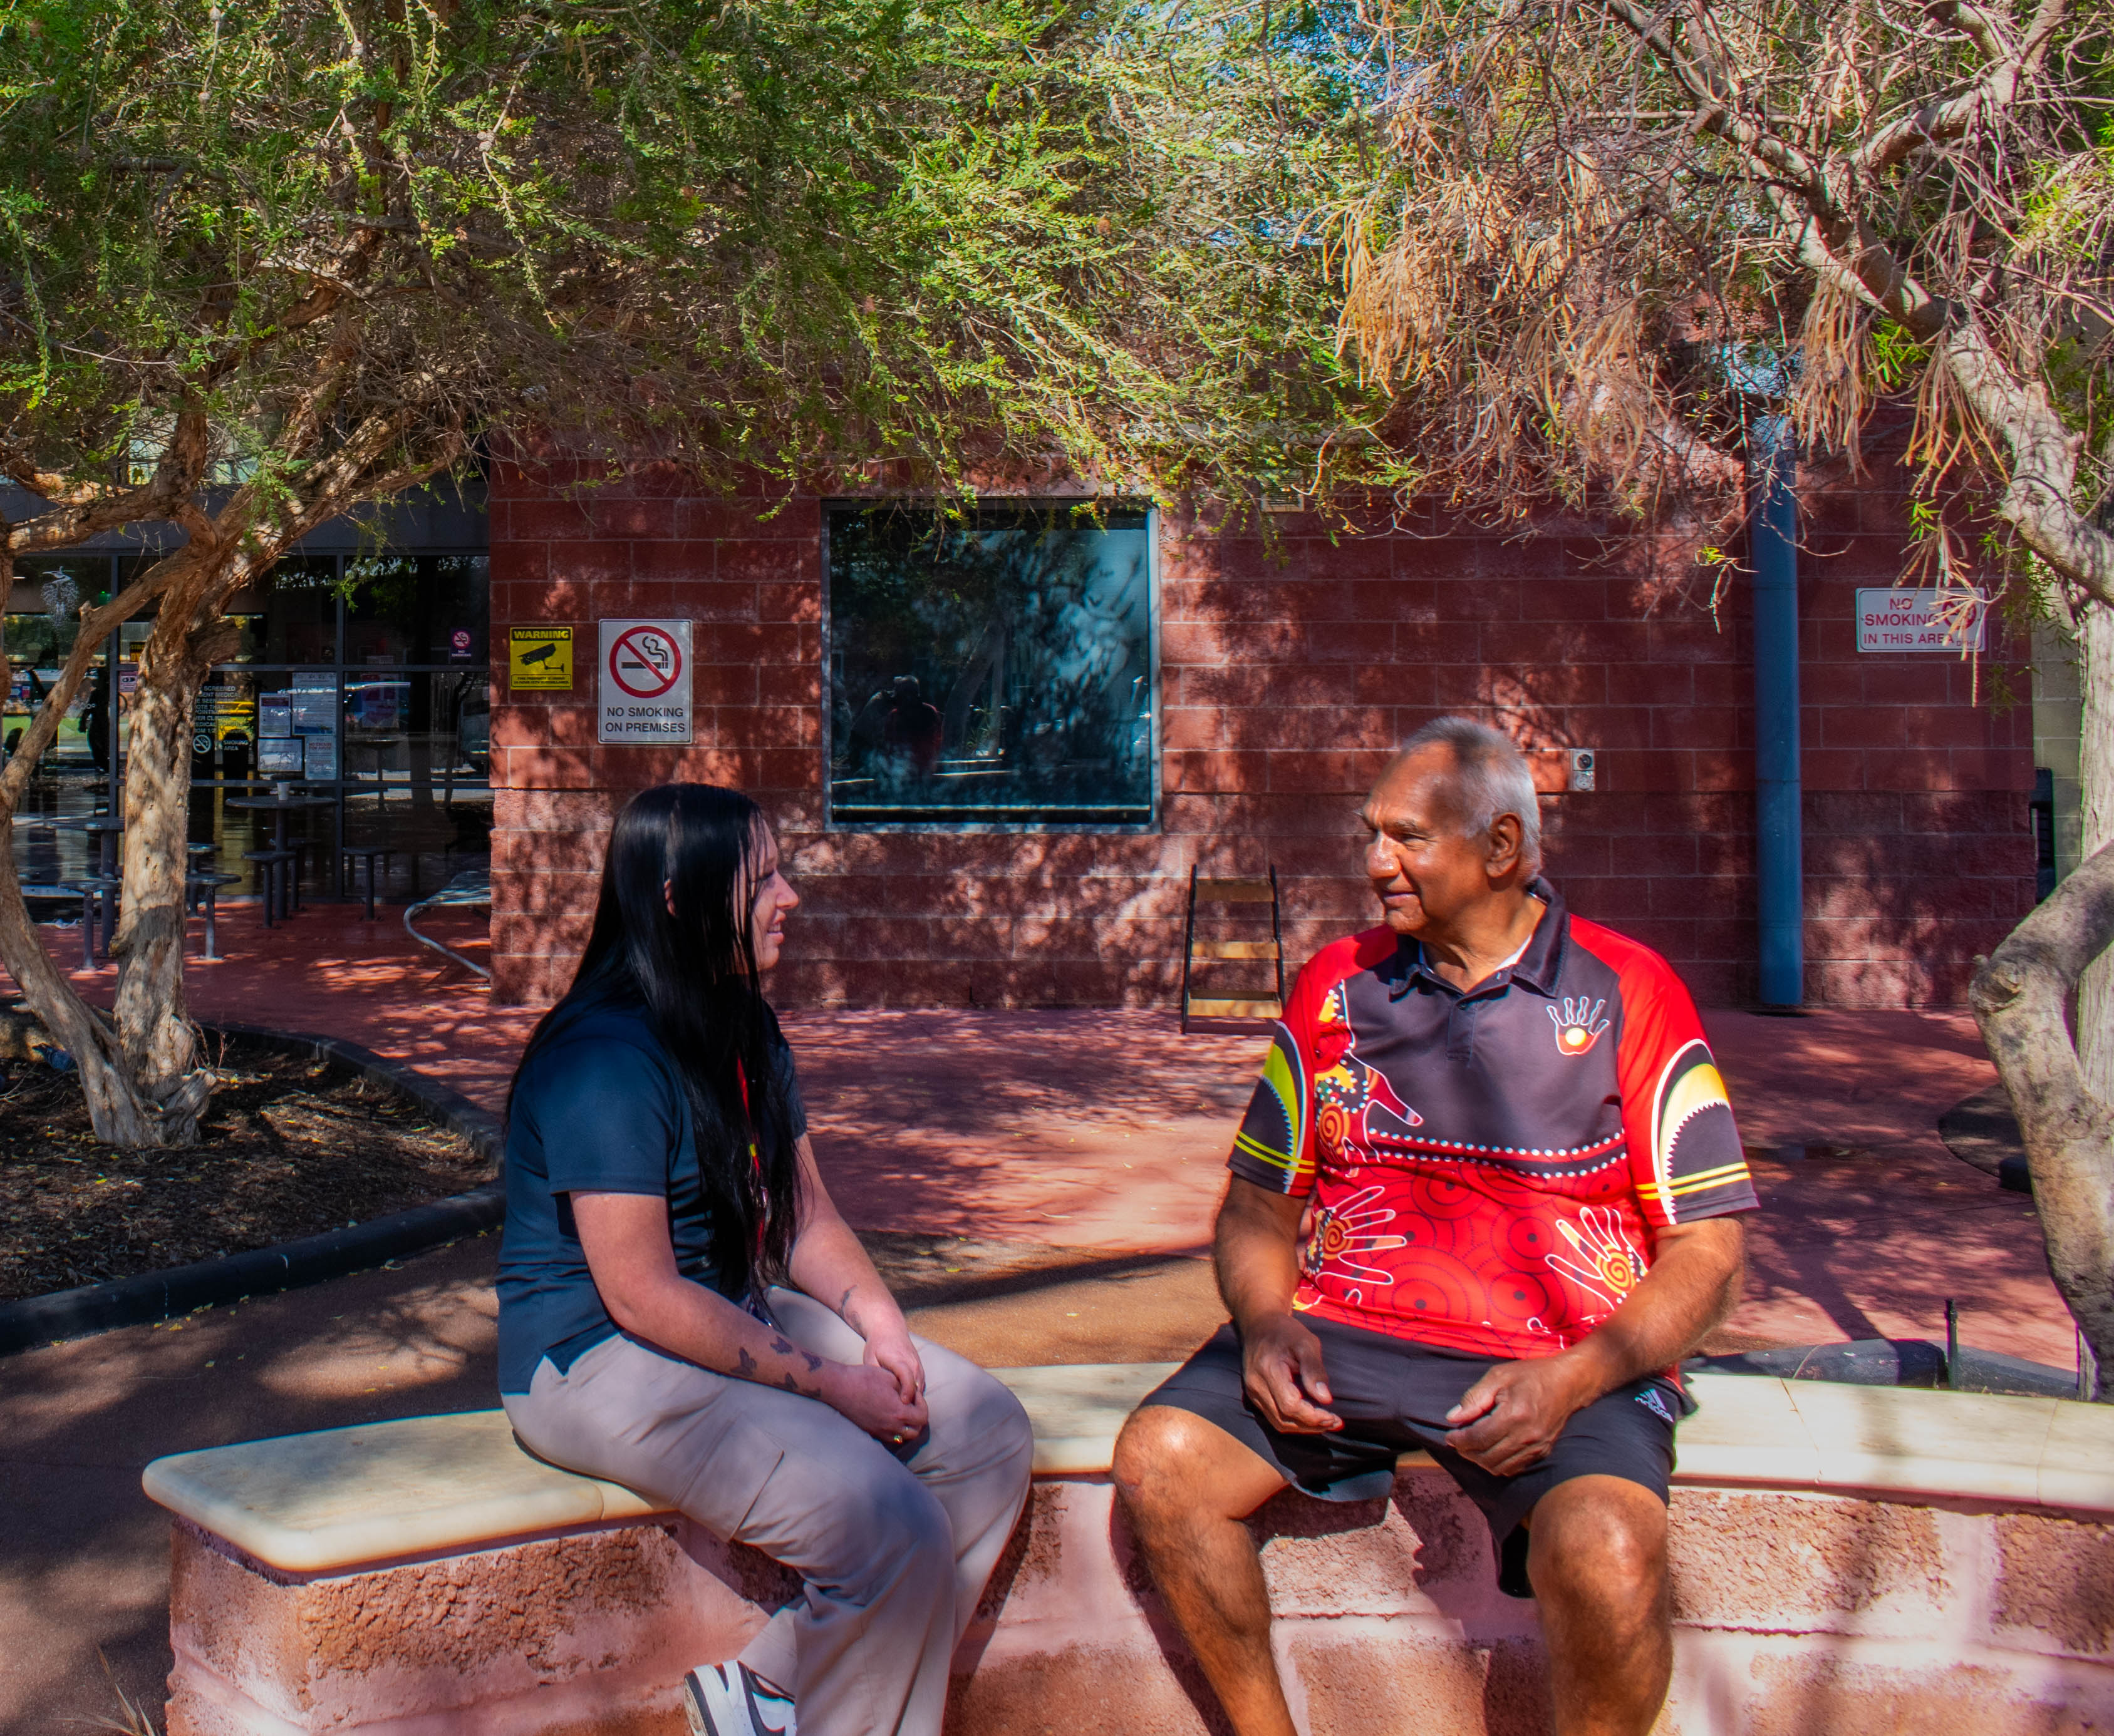
CQI in Practice
Hepatitis B
Case 2
70yo
CHB
Attending DYHS for > 20 years
Case finding through CHB audit
Review identified elevated LFTs
Referred directly for fibroscan: confirms fibrosis/ cirrhosis
Seen by hepatology CN and NP at RPH and commenced entecavir
Discussed at MDT: elevated risk portal HTN
Will be followed up by RPH hepatology team

Slide 42
CQI in Practice
RHD
Consistency of RHD management identified as a clinical concern
Patient files had variable diagnostic detail and ad-hoc recall
system for future care
Inconsistent documentation of treatment duration
Inconsistent notification of the WA State RHD Registrar of patients and treatment
Many transient patients on recall lists - use of staff resources

Slide 43
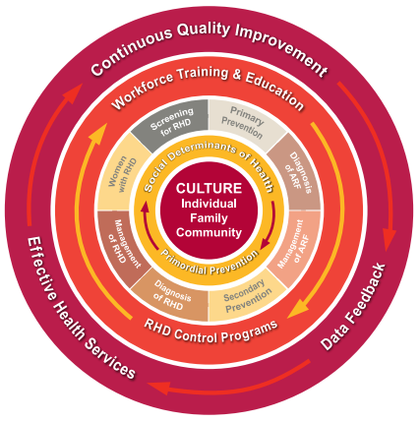
CQI in Practice
RHD
Audit tool created on Communicare, including automatic recalls for routine reviews and referrals
RHD diagnostic clinical items streamlined
Review of all files of patients with RHD diagnoses
– total of 340 Files
Liaison with WA State RHD Register and
notifications completed
RHD Medical review procedure created

Slide 44
CQI in Practice
RHD
Mammoth file audit completed : 340 files
All DYHS patients with RHD have accurate diagnoses, RHD priority classification, and management plan.
100% of patients have been notified to the RHD Register c/w 38 % in 2022
100 % have an Audit Item
On site echo clinics at the 4 sites
25 ECHOs completed at Derbarl in 2023
Recalls in place for echo
Communicare Audit report created

Slide 45
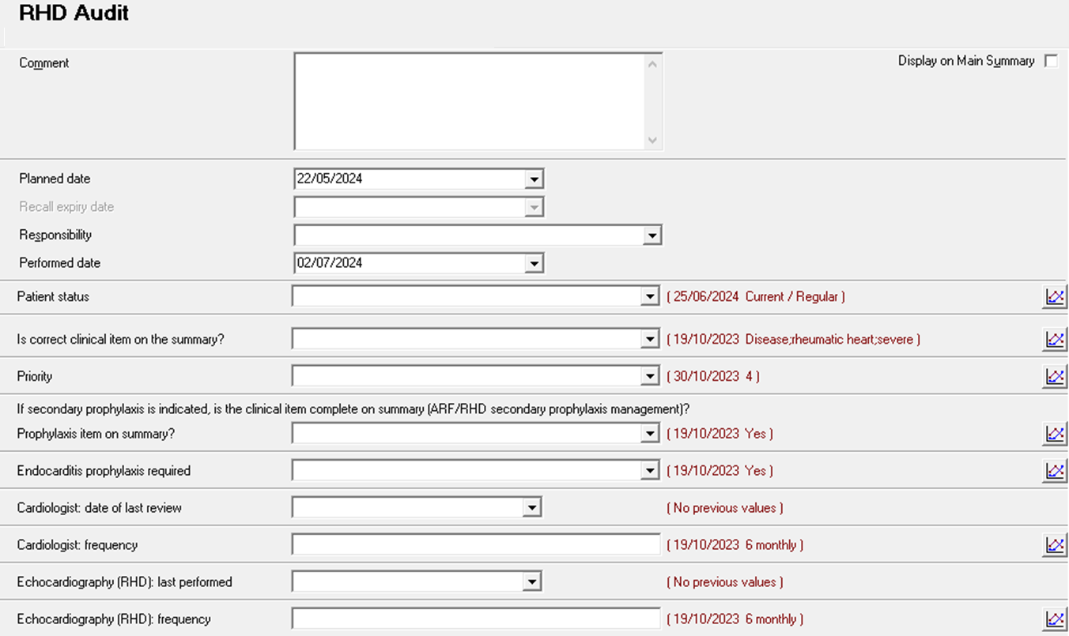
CQI in Practice
RHD

Slide 46
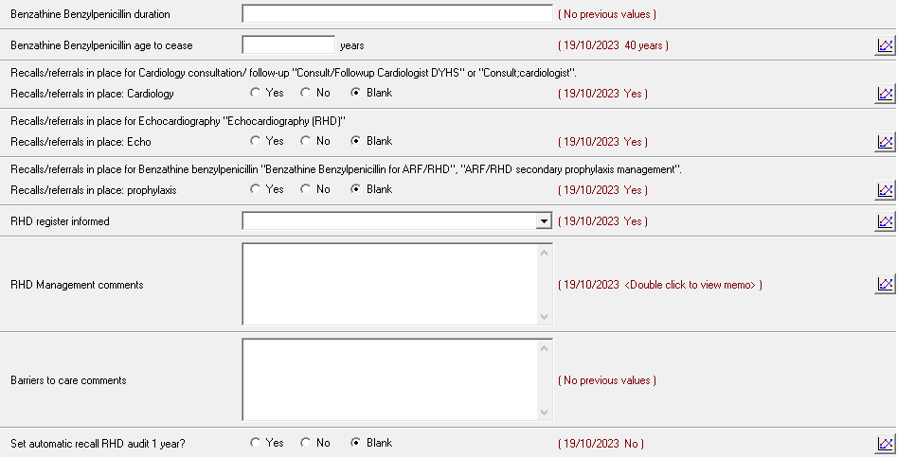
CQI in Practice
RHD

Slide 47
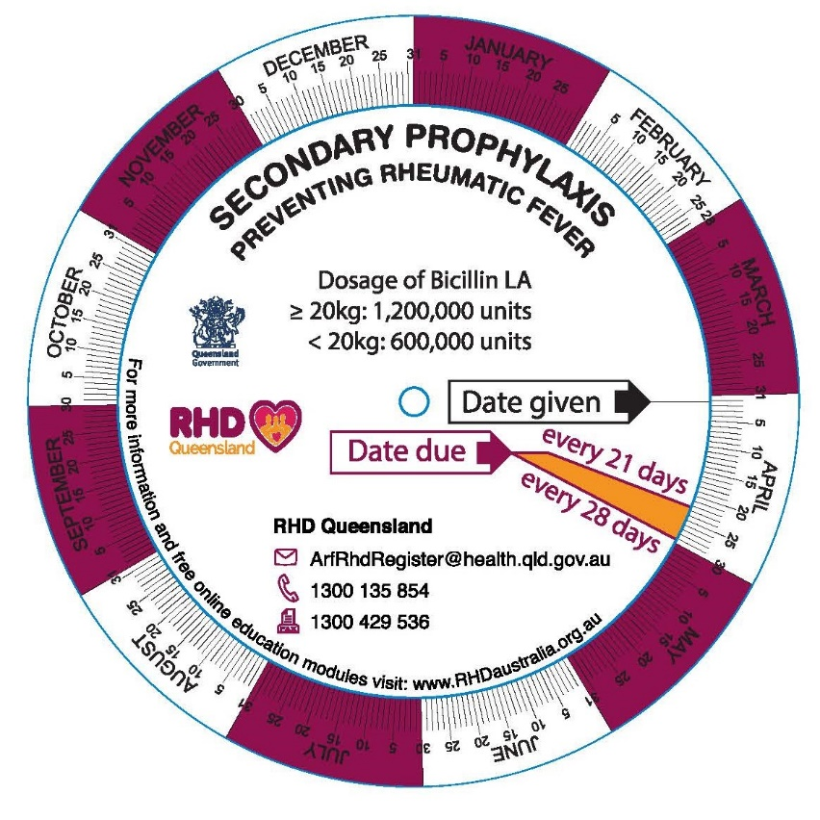
CQI in Practice
RHD
Case: 26 yo female
Diagnosed ARF 2013
Letter came 08/2021 advising to cease Bicillin, suggesting could have been stopped in 2018
Took 2 months to review letter, then another 6 months to perform Echo and see Cardiologist
8 months to action issue
Later confirmed by Cardiologist to cease Bicillin in April 2022
Unnecessarily took Bicillin for 4 years.
~50 very painful needles potentially administered without need

Slide 48
CQI in Practice
GP Pharmacist
WAPHA funding pharmacist to work on site in collaboration with the Pharmaceutical Society of Australia
Medication reviews
Happier clients, healthier patients
Staff education
Confident staff
Community pharmacy integration
Better wrap around support for patients
Medication audits
Eg. Heart Failure
Prevent future issues
Member of CQI Sub-Committee
Performing Spirometry
Health Promotions Team

Slide 49
CQI in Practice
GP Pharmacist
Example of intervention by GP Pharmacist
Pharmacist attended DYHS Elder’s Yarning group and met patient
Had very informal chat (yarn) with patient and identified opportunity for med review
Organised with patient for 1:1 session to discuss medications
Conducted 1:1 session late June
Identified that angina plan collaboration between hospital d/c and GP from April had not been implemented
Plan included dose changes and the addition of 3 new medications
Patient had no knowledge of plan
Contacted community pharmacy which was organizing DAA and confirmed they knew nothing about it
Liaised with GP, patient and pharmacy to start plan ASAP

Slide 50
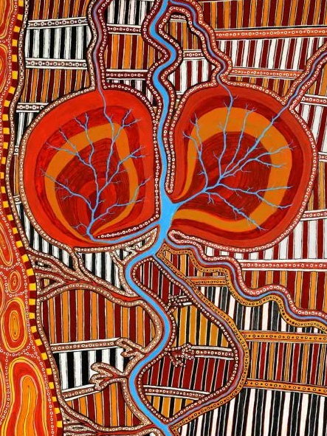
CQI in Practice
CKD
Chronic kidney disease affects a significant proportion of DYHS clients (> 500 Regular patients )
Historically low rates of people with end-stage CKD accessing renal transplant .Aboriginal Australians are less likely to receive a kidney transplant (13%) compared with non-Aboriginal Australians (51%)
Aim to achieve equity in access to a kidney transplant
Collaboration with 3 tertiary hospitals
Proactively addressing barriers to transplant work up

Slide 51
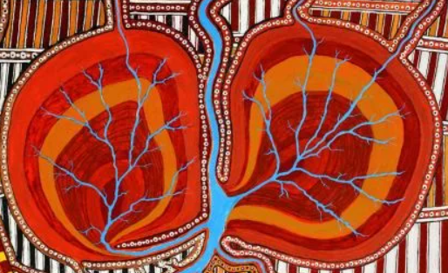
CQI in Practice
CKD
Communicare reports generated for haemodialysis , peritoneal dialysis and CKD stage 4/5
Kidney Transplant Work up Audit Item was created in collaboration with SCGH
MDT meetings every 3 months with SCGH/RPH and FSH
Nephrologist baseline transplant status determined
Barriers identified and actions required to address
Sharing of information required for work up eg: CST results, mammograms, vaccinations, skin checks, bowel screening

Slide 52
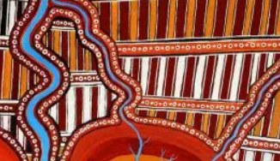
CQI in Practice
CKD
Communicare Audit report for CKD created
Transplant work up audit clinical item on all the files
Addressing temporary contraindications e.g smoking, BMI, poorly controlled DM and proactive recall of patients
Description | June 2023 | June 2024
No. of patients | 70 | 158
Transplanted | 4 | 8
Active on the transplant list | 0 | 3
Work up commenced | 10 | 10
Permanent CI | 17 | 31
Temporary CI | 33 | 67
Deceased | 5 | 12

Slide 53
Medical School Student Audits
The University of Notre Dame (Fremantle) School of Medicine incorporates a clinical audit project for each student during their degree
The School of Medicine has been partnering with DYHS for 4 years and achieved completion of 22 audits
Student audit highlights:
Ear screening audit gave us objective evidence for funding bodies
Advocate with NSW University for new clinical items for Otitis Media coding
Audit recommendations are implemented which benefits our patients
Yarning at conferences

Slide 54
Previous Notre Dame Audits
Otoscopy and Tymp screening
Management of Acute OM
Syphilis Management
Chlamydia Treatment
Hepatitis C
Syphilis
Atrial Fibrillation
Schizophrenia
Gestational Diabetes Mx
Rheumatic Heart Disease
Heart Failure Mx
Osteoarthritis
Diabetes Management
Osteoporosis screening
CST and Colposcopy Audit
Chlamydia Management
Otoscopy and Tymp screening
Management of Depression
CKD screening
CV High Risk & Optimal Care
Smokers: Assess & Mx
Periodontal disease & DM Mx

Slide 55
Women’s Health Cancer Screening
Mammography project
Aim is to increase rates of breast cancer screening
Aboriginal Health Practitioner actively recalling people who are overdue for screening
Convenient access to mammography (BreastScreen WA bus visit to East Perth clinic – 46 people screened in November 2023)
Cervical screening project:
CSTs; used Communicare reports on overdue CSTs; went to PRODA to verify if overdue;
Changed data entry for CSTs as a clinical item – updating from PRODA/other sites; adding recalls if overdue, removing recalls if already done. They simplified the clinical item list for consistency.
CST rate 39.8 to 69% across DYHS achieved via data cleansing.

Slide 56
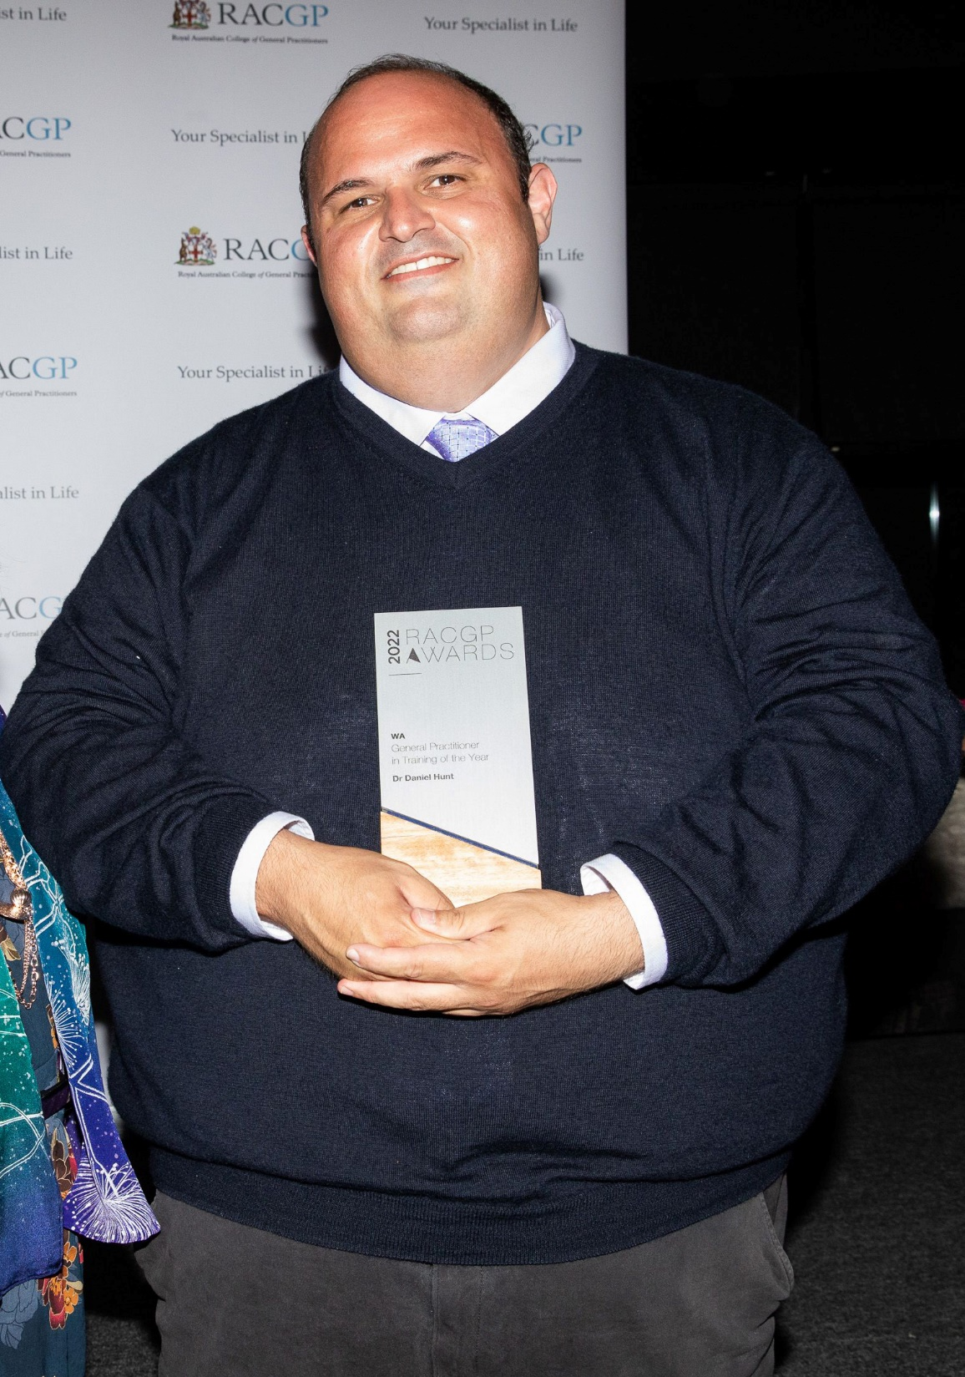
DYHS Fellow
Dr Daniel Hunt
Dr Hunt undertook multiple CQI projects during his GP Registrar training
His achievements were recognised in receiving the RACGP WA GP In Training of the Year award in 2022
Dr Hunt is now the Deputy Medical Director of DYHS
CQI projects include:
COVID-19 response
RHD
Syphilis
Patient Flow
Clinical Items
Policies and procedures

Slide 57
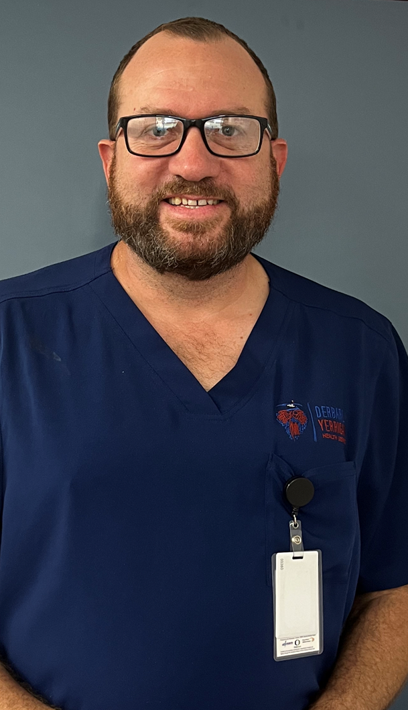
DYHS Registrar
Dr Corey Dalton
Dr Dalton was awarded the RACGP National GP In Training of the Year Award, 2023
His CQI projects include:
Visiting specialist clinics
(ENT and Paediatrics)
Child Health
Ear Health
Retinal screening
COVID-19 Hub
Med student teaching
Prison outreach

Slide 58
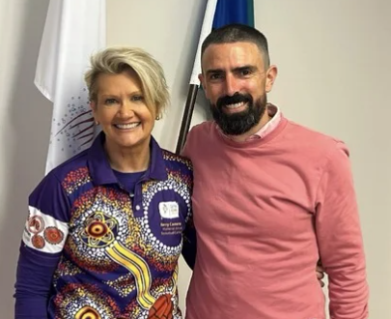
CQI in a nutshell
CQI Team
Buy in from the organization
Project lead
Sustainable funding
Good systems
Staff training
Data sharing
Patient safety
High quality care
Closing the gap

Slide 59
Acknowledgements
WA Primary Health Alliance ( WAPHA)
Rural Health West ( RHW)
BreastScreen WA
ASHM : Beyond the C
Royal Australian College of General Practitioners
University of Notre Dame Fremantle – School of Medicine
Medical students from Notre Dame, UWA and Curtin University
WA Rheumatic Heart Disease Register
Western Australian Department of Health Tertiary Hospitals : SCGH, RPH, FSH, KEMH
Sexual Health Quarters (SHQ)
Visiting specialists
Dr Harvey Coates: ENT Surgeon
GP Registrars : WAGPET, RACGP
DYHS Team
OUR PATIENTS

Slide 60
Barriers to CQI
Staff/Corporate understanding
Funding
Attitudes/resistance to change
Time
Competing priorities

Slide 61
CQI – Step by Step
Who
Identify the lead
What kind of character should they be
What are their strengths and weaknesses
Fill the team with diversity
Allied health
Admin staff
Creatives
Intellectuals
PASSION
Detail/Data oriented
What/Why
Identify your goals (SMART)
When
Allocation of time
Onsite vs Offsite
Protected, focused time required
How
FUNDING!

Slide 62
Panel Discussion
NACCHO Panel Discussion -
"How can you embed CQI in your Health Service?"

